Slide 1

ABSTRACT:
A Grocery store shared a transactional data, to identify the most popular combo, through the most commonly occurring sets of menu items in the customer orders.
SUMMARY:
The project aims to analyse the association rules to suggest the best combo and offers for the grocery store using Market Basket Anlaysis.
Yashveer Kothari .A
POST GRADUATE PROGRAM IN DATA SCIENCE AND BUSINESS ANALYTICS
MARKET RETAIL ANALYTICS MILESTONE 2

Slide 2
TABLE OF CONTENTS
PROBLEM STATEMENT
DATA ANALYSIS 1. data info, description, summary. 2. Univariate, bivariate &multi variate analysis
CUSTOMER SEGMENTATION USING RFM ANALYSIS 1. Tools used & predictions 2. output table 3. KNIME workflow
RFM INFERENCES AND IDENTIFIERS 1. BEST CUSTOMER 2. CUSTOMER ON THE VERGE OF CHURNING 3.LOST CUSTOMERS 4. LOYAL CUSTOMERS

Slide 3
PROBLEM STATEMENT
A Grocery Store shared the transactional data with you. Your job is to identify the most popular combos that can be suggested to the Grocery Store chain after a thorough analysis of the most commonly occurring sets of menu items in the customer orders. The Store doesn’t have any combo meals. Can you suggest the best combo meals?

Slide 4
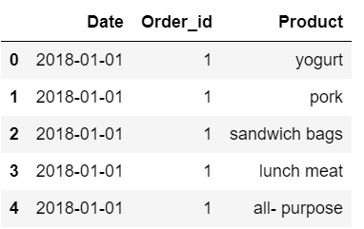
DATA ANALYSIS – DATASET SAMPLE

Slide 5

DATA ANALYSIS – DATASET DESCRIPTION
There are a total of 1139 orders in the dataset

Slide 6
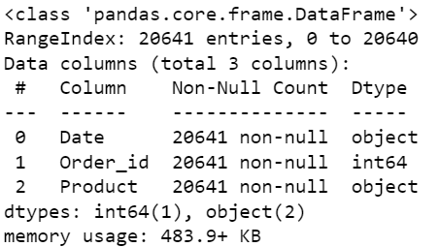
DATA ANALYSIS – DATASET INFORMATION
There are a total of 20641 entries and 3 Variables.
From the 3 variables, 1 is integer type variable and 2 are object type variables.
There are no missing values in the dataset.

Slide 7
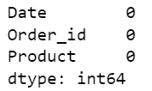
DATA ANALYSIS – MISSING VALUE AND DUPLICATES
There are no missing values in the dataset.
There are a total of 4730 duplicates in the dataset.
The duplicates are removed from the dataset.

Slide 8
EXPLORATORY DATA ANALYSIS
Exploratory data analysis (EDA) is an approach of analyzing data sets to summarize their main characteristics, often using statistical graphics and other data visualization methods.
The pre-processing of the data is done using python and saved as an excel file and further KNIME and Tableau is performed.
Tableau Link: https://public.tableau.com/app/profile/yashveer8746/viz/MRAMilestone2YashveerKothariA/DaywiseTrend?publish=yes

Slide 9
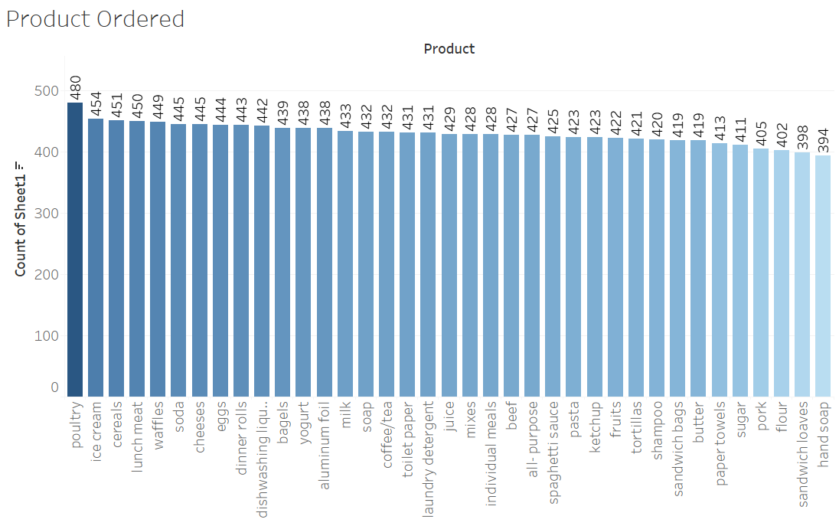

Products ordered

Slide 10
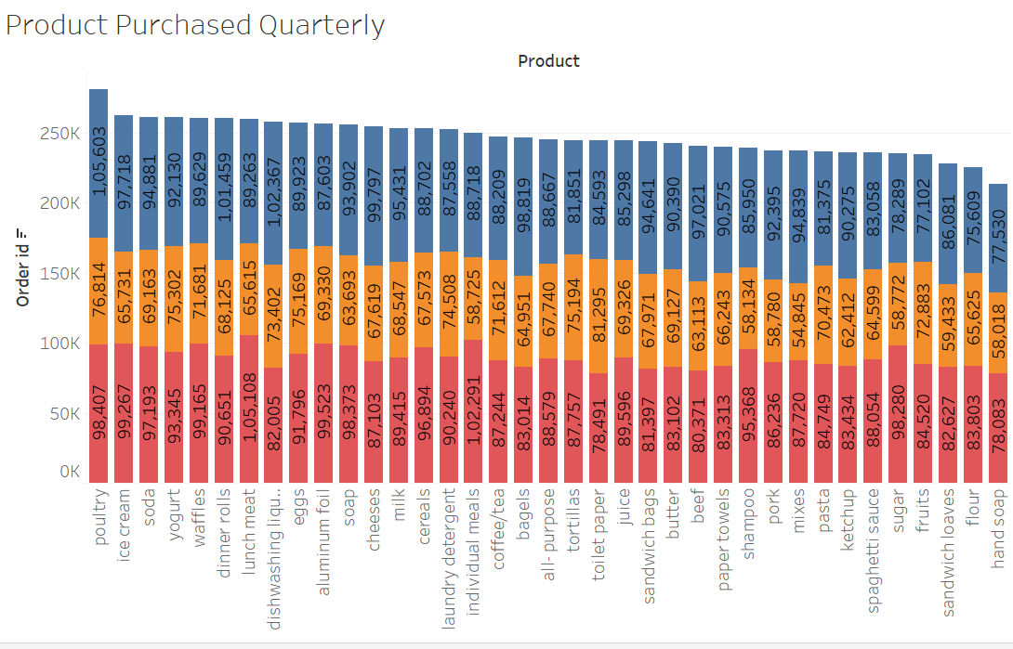
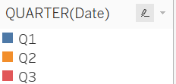
Products Purchased quarterly

Slide 11
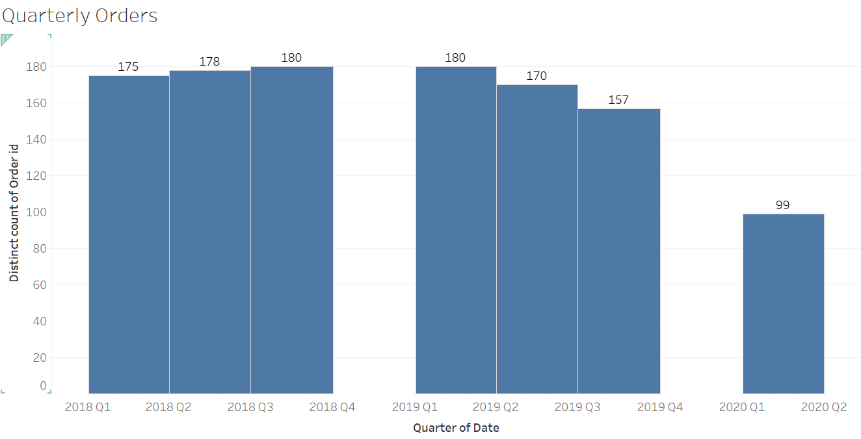
Quarterly orders

Slide 12
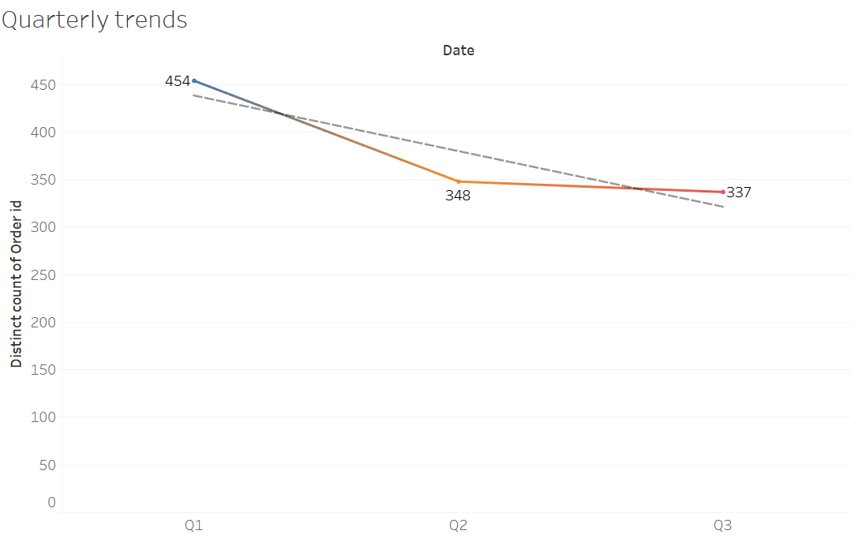
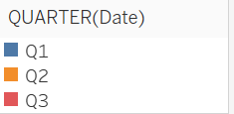
Quarterly TRENDS

Slide 13
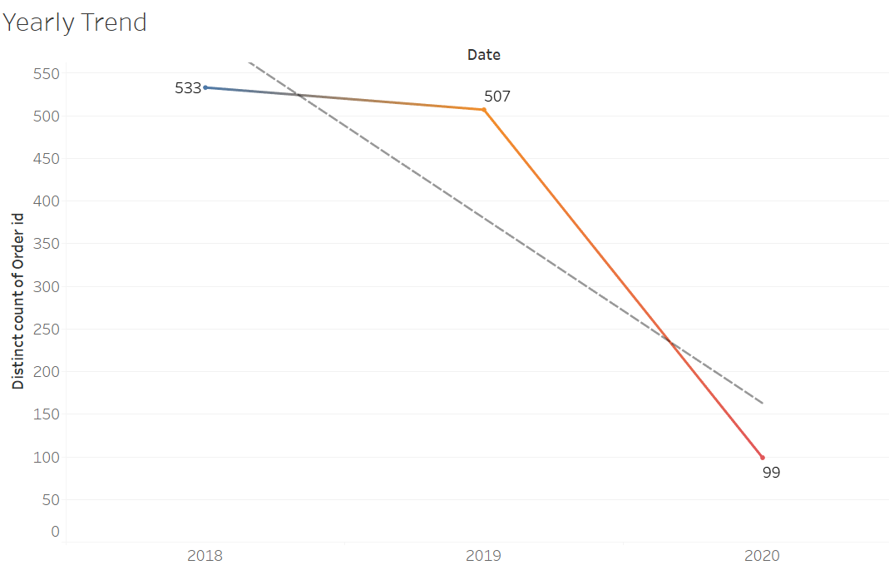
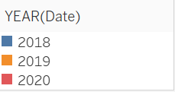
YEARLY TRENDS

Slide 14
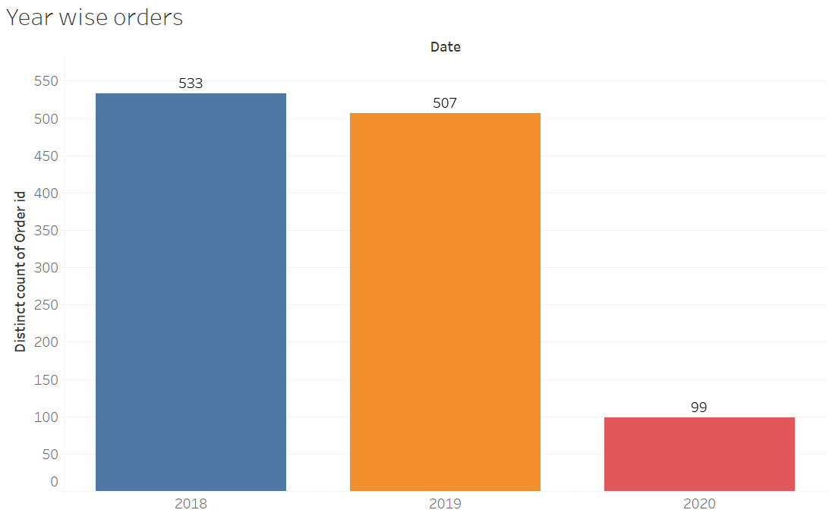
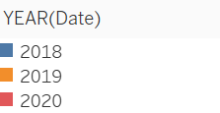
YEAR WISE ORDERS

Slide 15
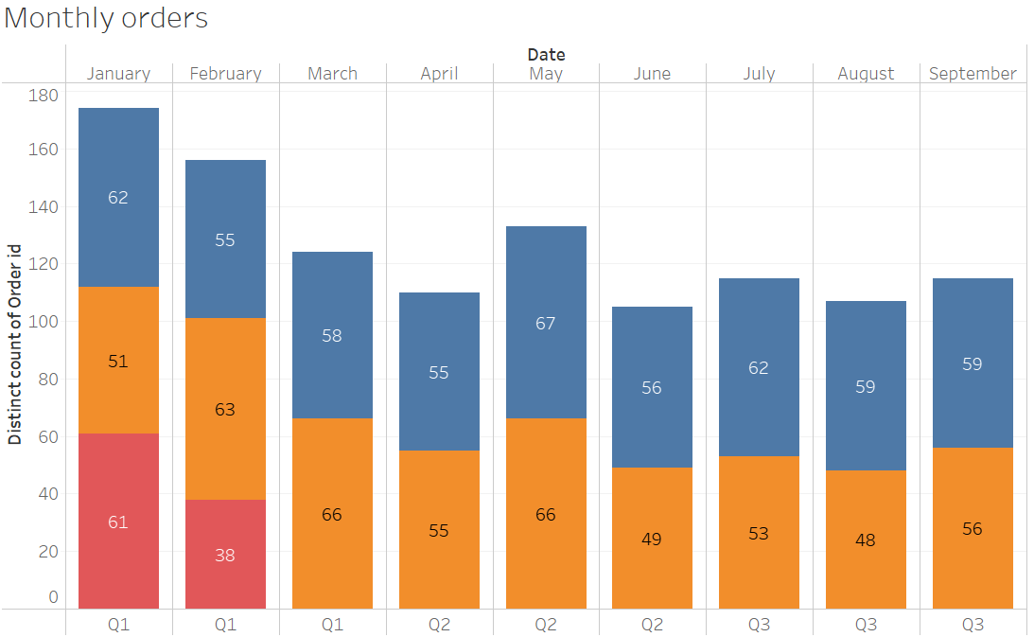
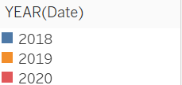
MONTHLY ORDERS

Slide 16
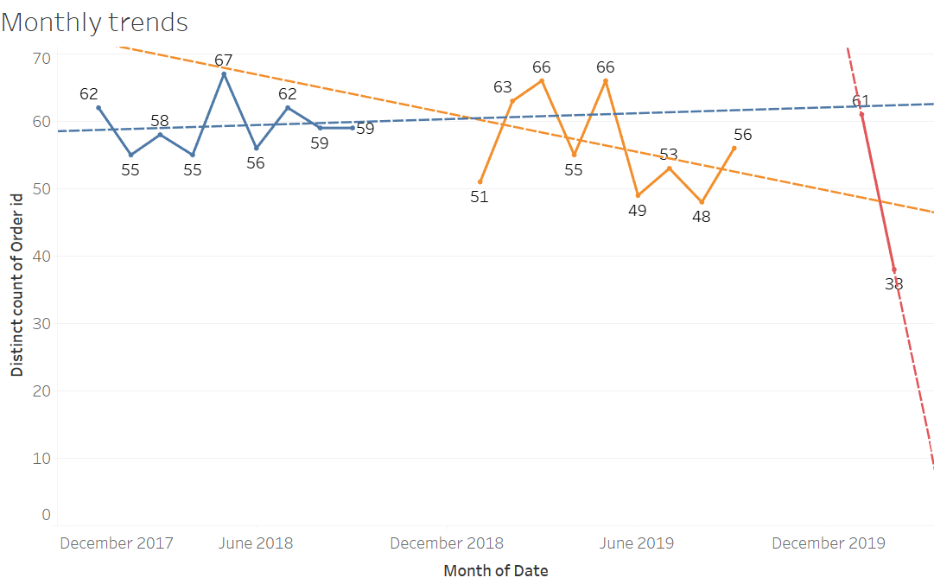
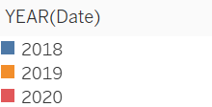
MONTHLY TRENDS

Slide 17
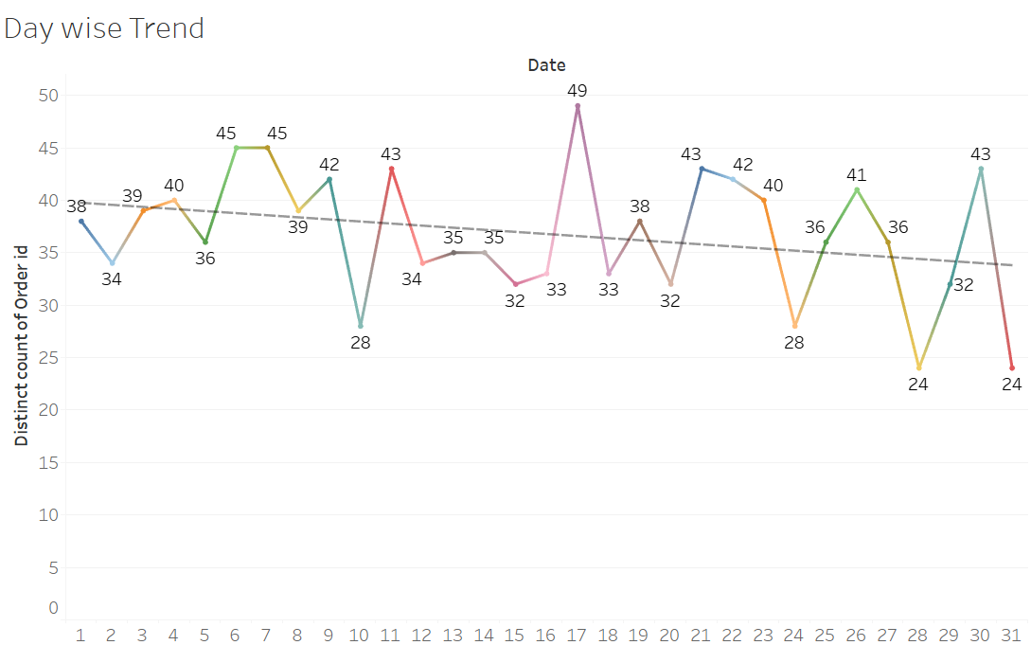
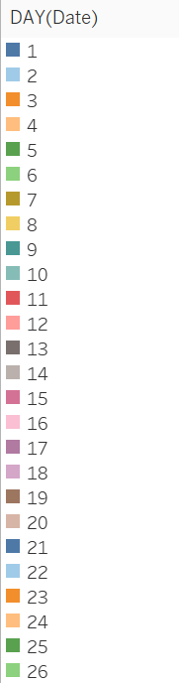
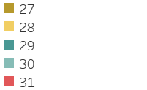
DAY WISE TRENDS

Slide 18
INFERENCES FROM THE ABOVE EDA
In 2018, the number of the orders are the highest amongst the consolidated data and 2020 is the lowest numbers of orders, ,may be because there is data available for two months only.
Poultry is the only product ordered the most, it is a part of 480 orders out of 1139 orders, followed by ice cream, cereals etc.
Hand soap is ordered the least amongst all the products and is a part of 394 orders.
Orders trend as seen in products purchased quarterly and other trends, it can be observed that 2018 is the year where the orders where the all time high and eventually decreasing year wise.
In the quarterly orders it can be seen that the Q3 of year 2018 has the highest number of orders followed by q1 of year 2019.
In the monthly orders it can be observed that month January and February have the highest orders taken.

Slide 19
MRA – ASSOCIATION RULES and market basket analysis
1. Market Basket Analysis is one of the key techniques used by large retailers to uncover associations between items. It works by looking for combinations of items that occur together frequently in transactions. To put it another way, it allows retailers to identify relationships between the items that people buy.
2.Association Rules are widely used to analyze retail basket or transaction data, and are intended to identify strong rules discovered in transaction data using measures of interestingness, based on the concept of strong rules.
3. Support: It is the default of an item, the support of item A is nothing but the ratio of transactions involving A to the total involving A to the total number of transactions.

Slide 20
MRA – ASSOCIATION RULES and market basket analysis contd…
4. Confidence: It is the default popularity of an item. In mathematical terms, the support of item A is nothing but the ratio of transactions involving A to the total number of transactions.
5. Lift: Increase in sales of A when you sell B

Slide 21
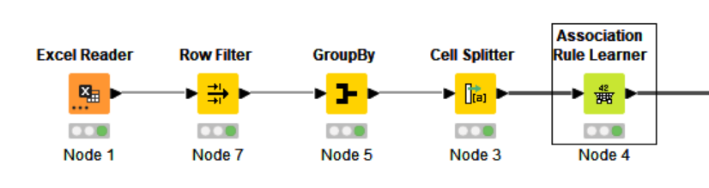
KNIME WORK FLOW

Slide 22
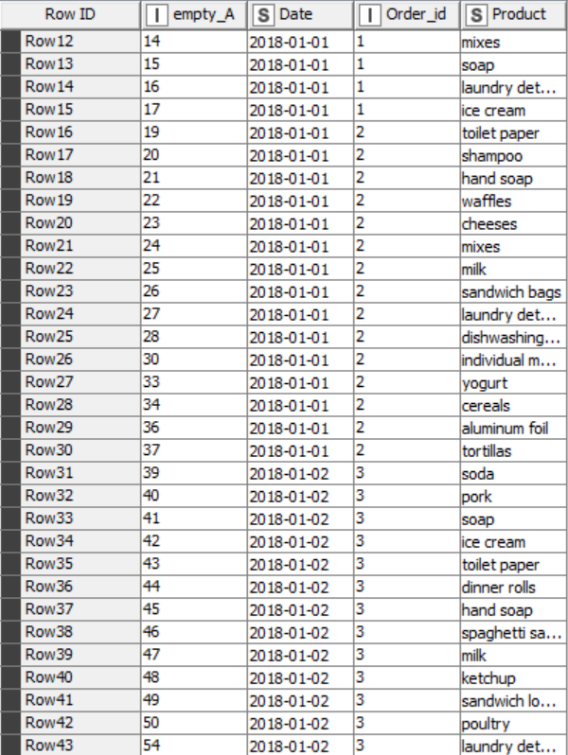
READING THE EXCEL FILE

Slide 23
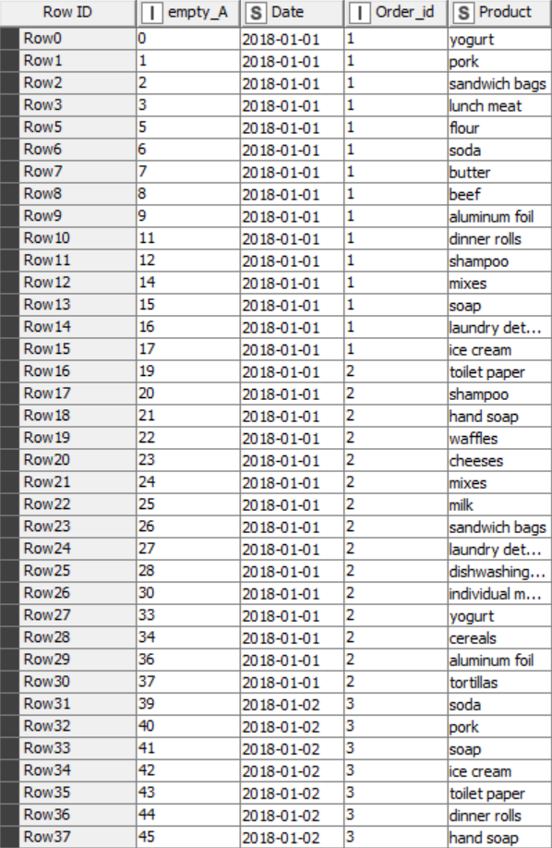
ROW FILTER
Filtering the All purpose, as it seems irrelevant.

Slide 24
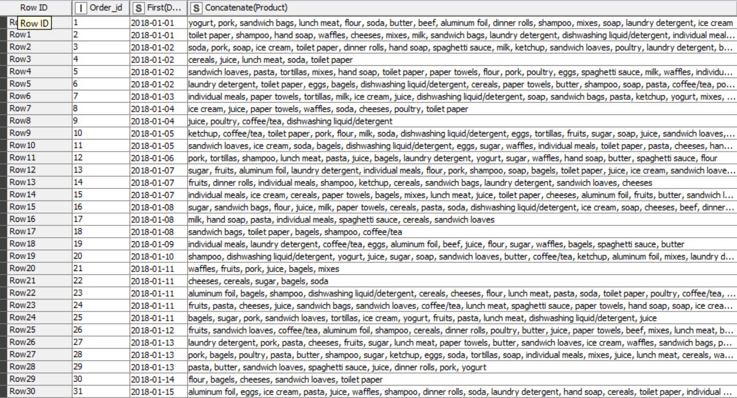
GROUPBY
The filtered data is then grouped by the ORDER ID variable and concatenated .

Slide 25
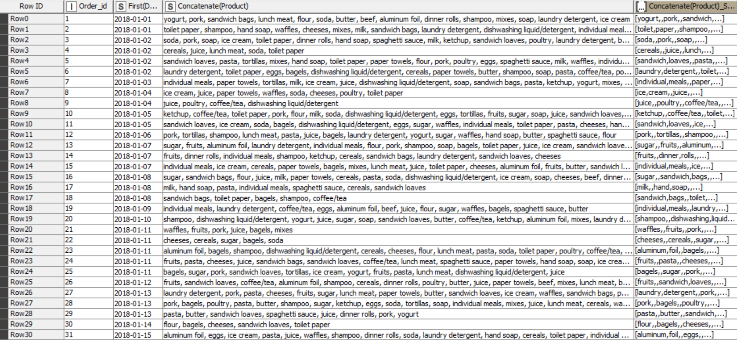
CELL - SPLITTER
Here we remove the duplicated values and concatenate as per product, which helps to classify items in set format

Slide 26
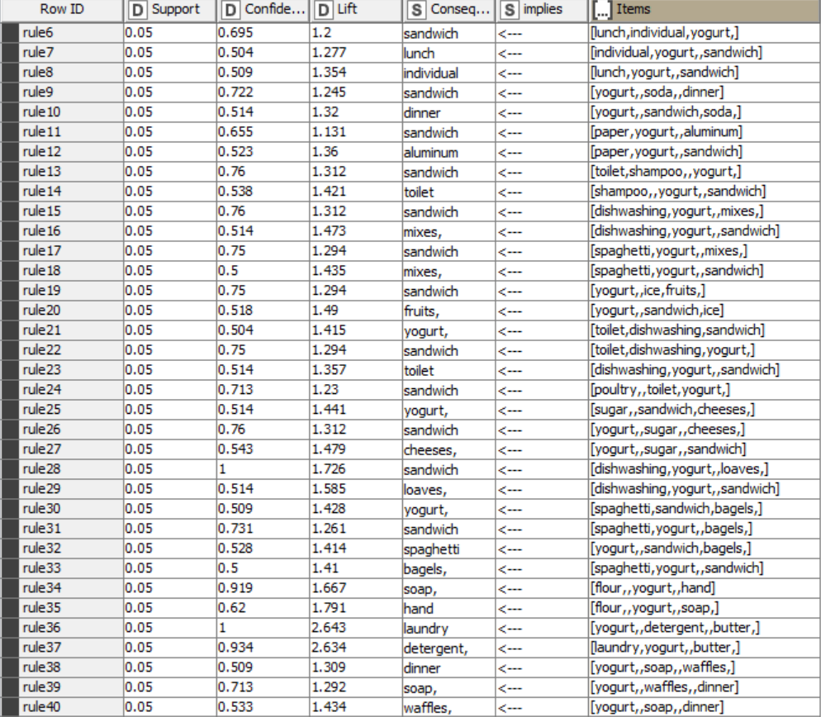
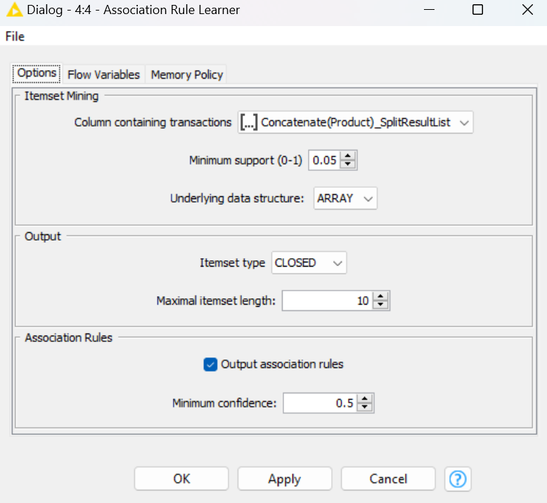
MBA – Association rule

Slide 27
MBA – Association rule contd…
The threshold values are
Support: 0.05
Confidence: 10
Lift: 0.5
In this problem I am applying Association rule with certain level of support and confidence threshold so that I can generate rules which can help me to club product in such way that business can make use of it and sale more products to customers.
The number of transactions that include items in the {X} and {Y} then
•Support = (X+Y)/total
•Conf(X=>Y) = Supp(XUY) /Supp(X)
•Lift(X=>Y) = Conf(X=>Y)/ Supp(Y)

Slide 28
RECOMMENDATIONS
1. The Grocery store can give discounts on the combos.
2. It can make some attractive packaging for the combos based on the analysis above so that the customer is attracted more to it.
3. Customers buying mixes can buy sandwich, yoghurt.
4.Customers buying sandwich can buy ketchup and paper towels.
5. Customers buying sauce can buy spaghetti, dishwashing, butter.
6. The grocery store can run combos on Hand soap and toilet paper, sauce, pasta/ spaghetti and soda. These products have high chances of customers to buy this together, which will increase the sales.
7. Stores can run buy one get one , Buy two get one offers like
Buy sandwich and cheese and get hand soap free.
8. In such combos the grocery store can push out old stock at lesser margin, this will help the grocery store to get products of high demand and reduce inventory.
9. Since poultry and soda are the most sold items and hand soap and Sandwich loaves are least a combo offer can boost the sales of the hand soap and sandwich loaves.
10. We can offer special coupons for buying the least sold items, the coupon should be a discount coupon providing discounts on there next purchase from the store, which will increase the sale of the least sold product and the customer visits the store again for a purchase

